Slide 1

Digital Integrated Circuits
A Design Perspective
Jan M. Rabaey
Anantha Chandrakasan
Borivoje Nikolic
Manufacturing
Process
July 30, 2002

Slide 2
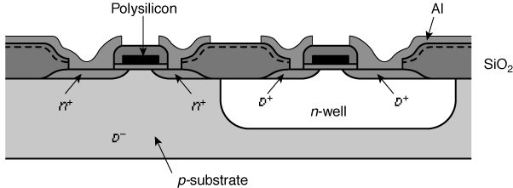
CMOS Process

Slide 3
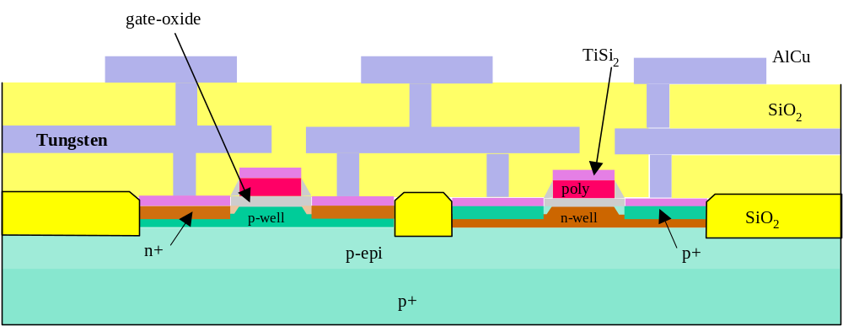
A Modern CMOS Process
Dual-Well Trench-Isolated CMOS Process

Slide 4
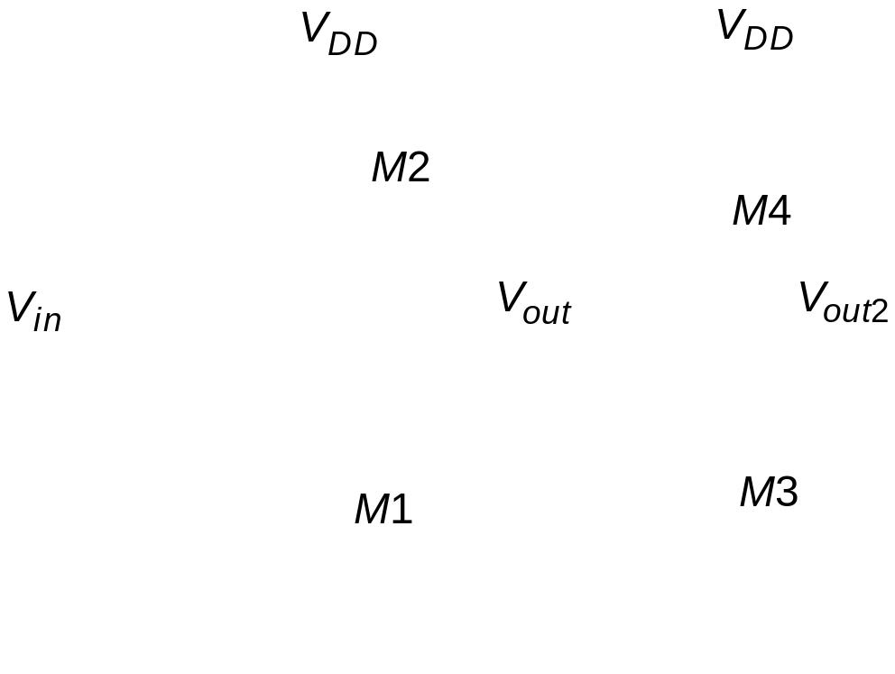
Circuit Under Design

Slide 5

Its Layout View

Slide 6
The Manufacturing Process
For a great tour through the IC manufacturing process
and its different steps, check
http://www.fullman.com/semiconductors/semiconductors.html

Slide 7
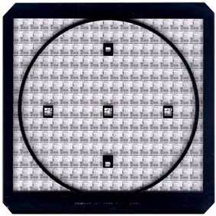
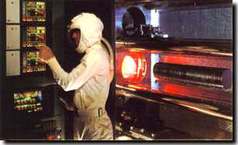
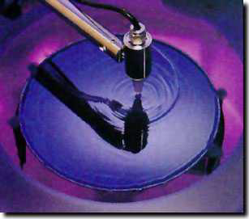
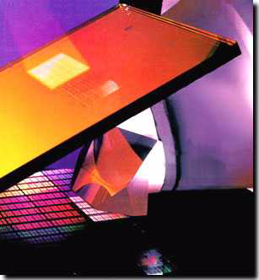
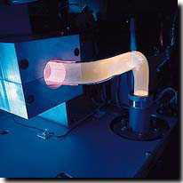
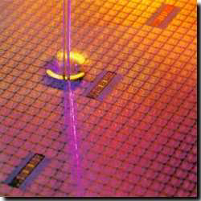
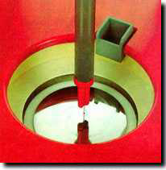
Photo-Lithographic Process
optical
mask
oxidation
photoresist
photoresist coating
removal (ashing)
stepper exposure
Typical operations in a single
photolithographic cycle (from [Fullman]).
photoresist
development
acid etch
process
spin, rinse, dry
step

Slide 8
Patterning of SiO2
Chemical or plasma
etch
Si-substrate
Hardened resist
SiO
2
(a) Silicon base material
Si-substrate
Photoresist
SiO
2
(d) After development and etching of resist,
Si-substrate
chemical or plasma etch of SiO
2
(b) After oxidation and deposition
Hardened resist
of negative photoresist
SiO
2
Si-substrate
UV-light
Patterned
(e) After etching
optical mask
Exposed resist
SiO
2
Si-substrate
Si-substrate
(c) Stepper exposure
(f) Final result after removal of resist

Slide 9
CMOS Process at a Glance
Define active areas
Etch and fill trenches
Implant well regions
Deposit and pattern
polysilicon layer
Implant source and drain
regions and substrate contacts
Create contact and via windows
Deposit and pattern metal layers

Slide 10
CMOS Process Walk-Through
p-epi
(a) Base material: p+ substrate
with p-epi layer
p
+
Si
N
3
4
p-epi
SiO
2
(b) After deposition of gate-oxide and
sacrificial nitride (acts as a
buffer layer)
p
+
(c) After plasma etch of insulating
trenches using the inverse of
p
+
the active area mask

Slide 11
CMOS Process Walk-Through
SiO
2
(d) After trench filling, CMP
planarization, and removal of
sacrificial nitride
n
(e) After n-well and
V
Tp
adjust implants
p
(f) After p-well and
V
Tn
adjust implants

Slide 12
CMOS Process Walk-Through
poly(silicon)
(g) After
polysilicon deposition
and etch
n
+
p
+
(h) After
n
+
source/drain and
p
+
source/drain implants. These
steps also dope the polysilicon.
SiO
2
(i) After deposition of SiO
2
insulator and contact hole etch.

Slide 13
CMOS Process Walk-Through
Al
(j) After deposition and
patterning of first Al layer.
Al
SiO
2
(k) After deposition of SiO
2
insulator, etching of via’s,
deposition and patterning of
second layer of Al.

Slide 14
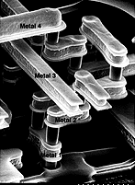
Advanced Metallization

Slide 15
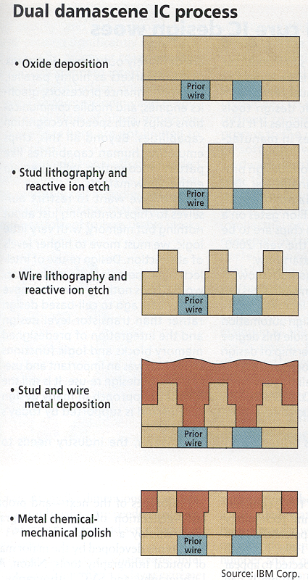
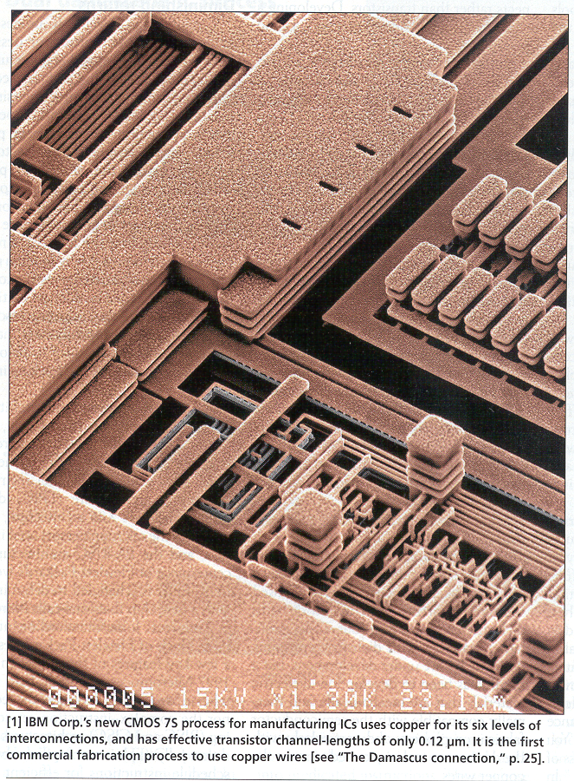
Advanced Metallization

Slide 16
Design Rules

Slide 17
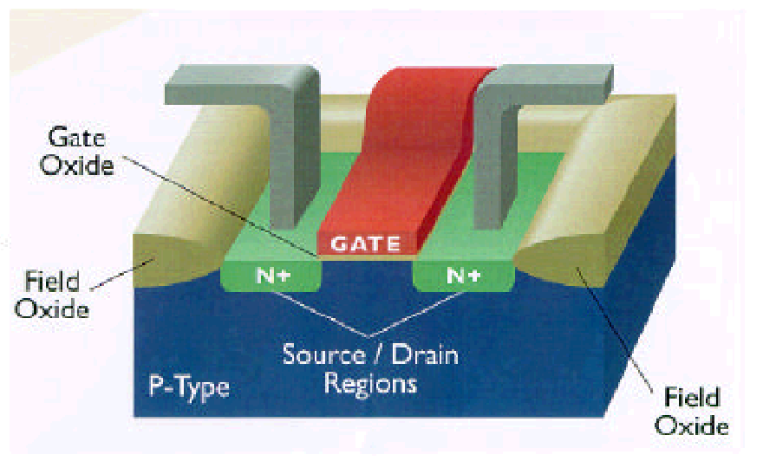
3D Perspective
Polysilicon
Aluminum

Slide 18
Design Rules
Interface between designer and process engineer
Guidelines for constructing process masks
Unit dimension: Minimum line width
  scalable design rules: lambda parameter
  absolute dimensions (micron rules)

Slide 19
CMOS Process Layers
Layer
Color
Representation
Well (p,n)
Yellow
Active Area (n+,p+)
Green
Select (p+,n+)
Green
Polysilicon
Red
Metal1
Blue
Metal2
Magenta
Contact To Poly
Black
Contact To Diffusion
Black
Via
Black

Slide 20
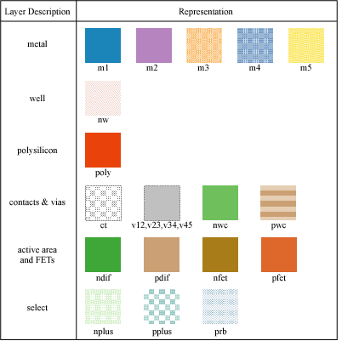
Layers in 0.25 μm CMOS process

Slide 21
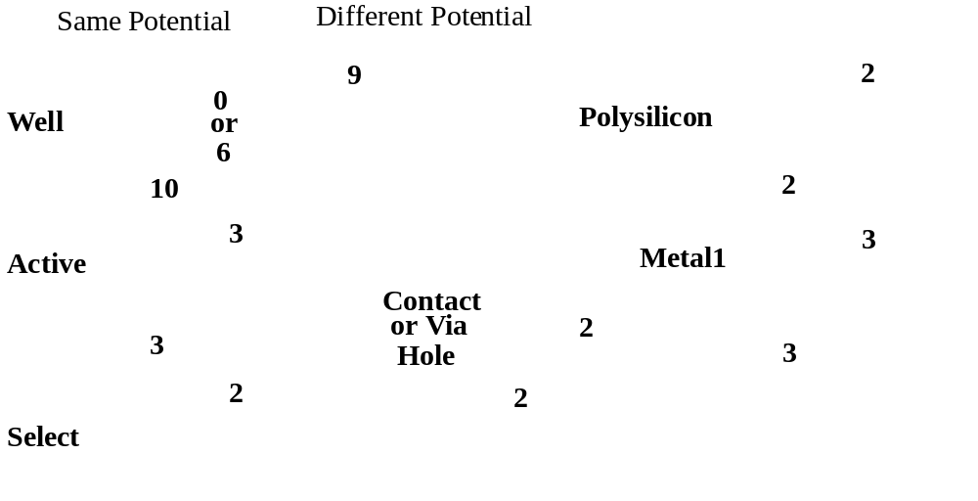
Intra-Layer Design Rules
4
Metal2
3

Slide 22

Transistor Layout

Slide 23
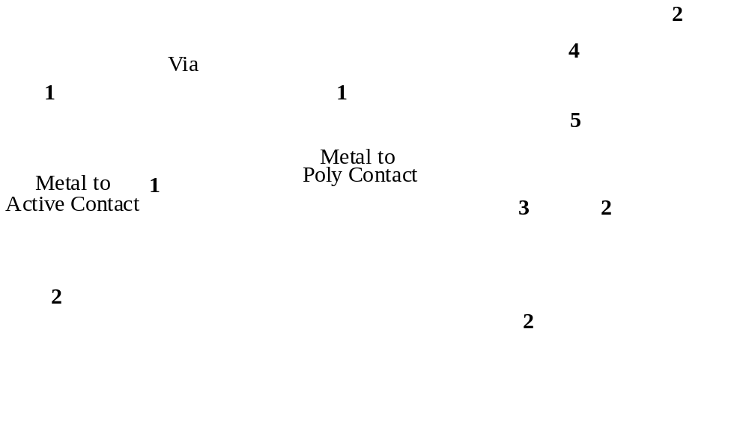
Vias and Contacts

Slide 24
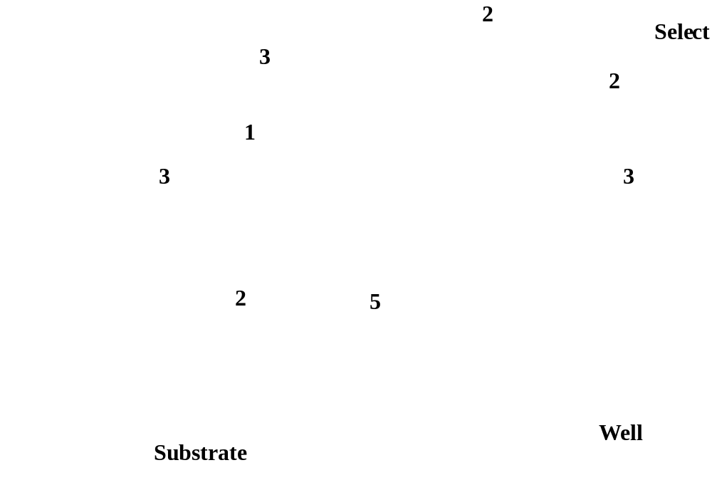
Select Layer

Slide 25
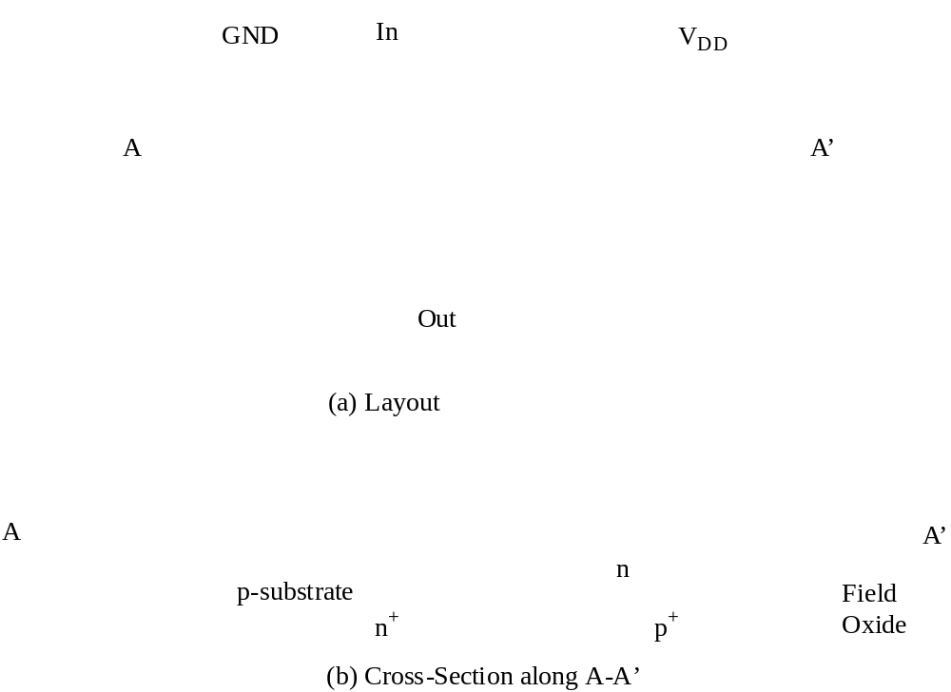
CMOS Inverter Layout

Slide 26
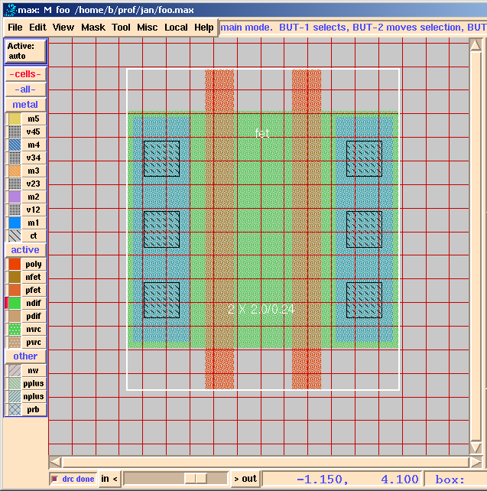
Layout Editor

Slide 27

Design Rule Checker
poly_not_fet to all_diff minimum spacing = 0.14 um.

Slide 28
Sticks Diagram
V
DD
3
In
Out
Dimensionless layout entities
Only topology is important
Final layout generated by
“compaction” program
1
GND
Stick diagram of inverter

Slide 29
Packaging

Slide 30
Packaging Requirements
Electrical: Low parasitics
Mechanical: Reliable and robust
Thermal: Efficient heat removal
Economical: Cheap

Slide 31
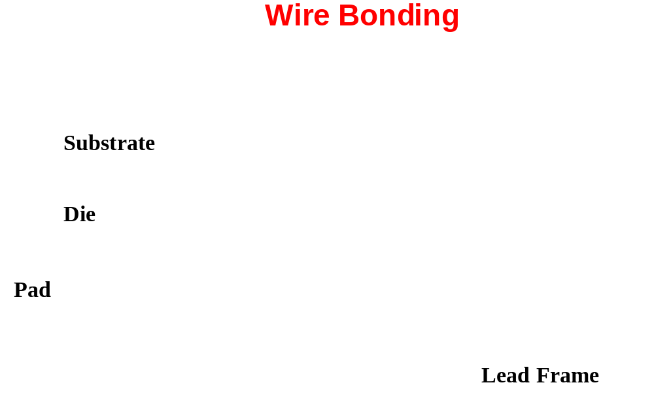
Bonding Techniques

Slide 32
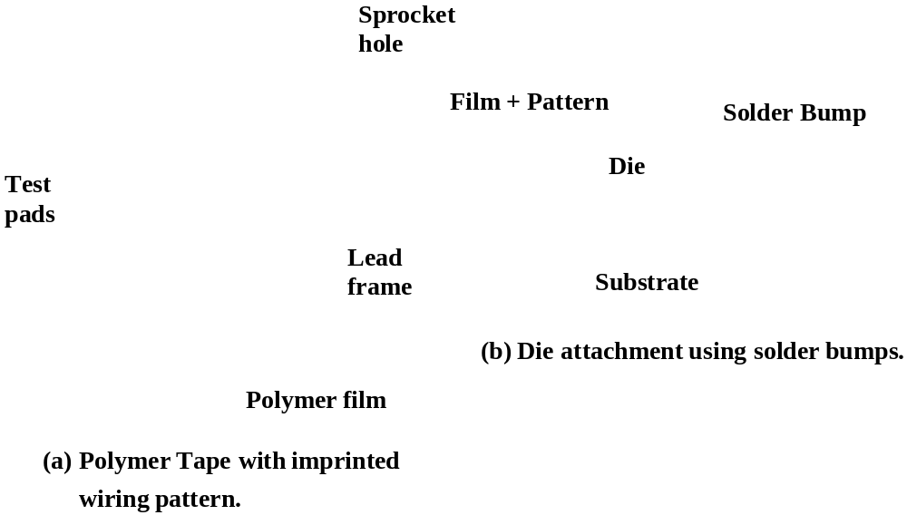
Tape-Automated Bonding (TAB)

Slide 33
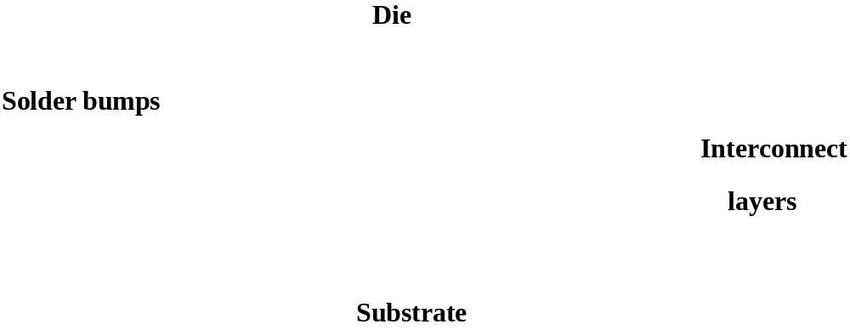
Flip-Chip Bonding

Slide 34
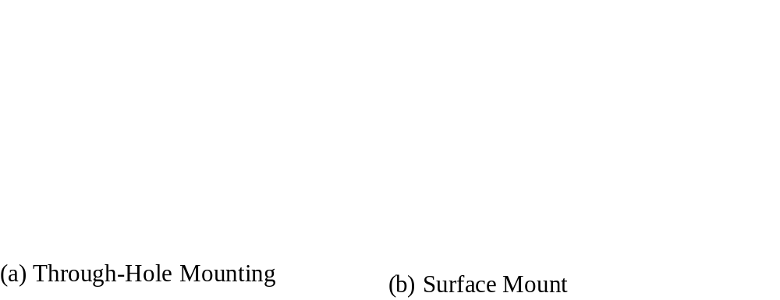
Package-to-Board Interconnect

Slide 35
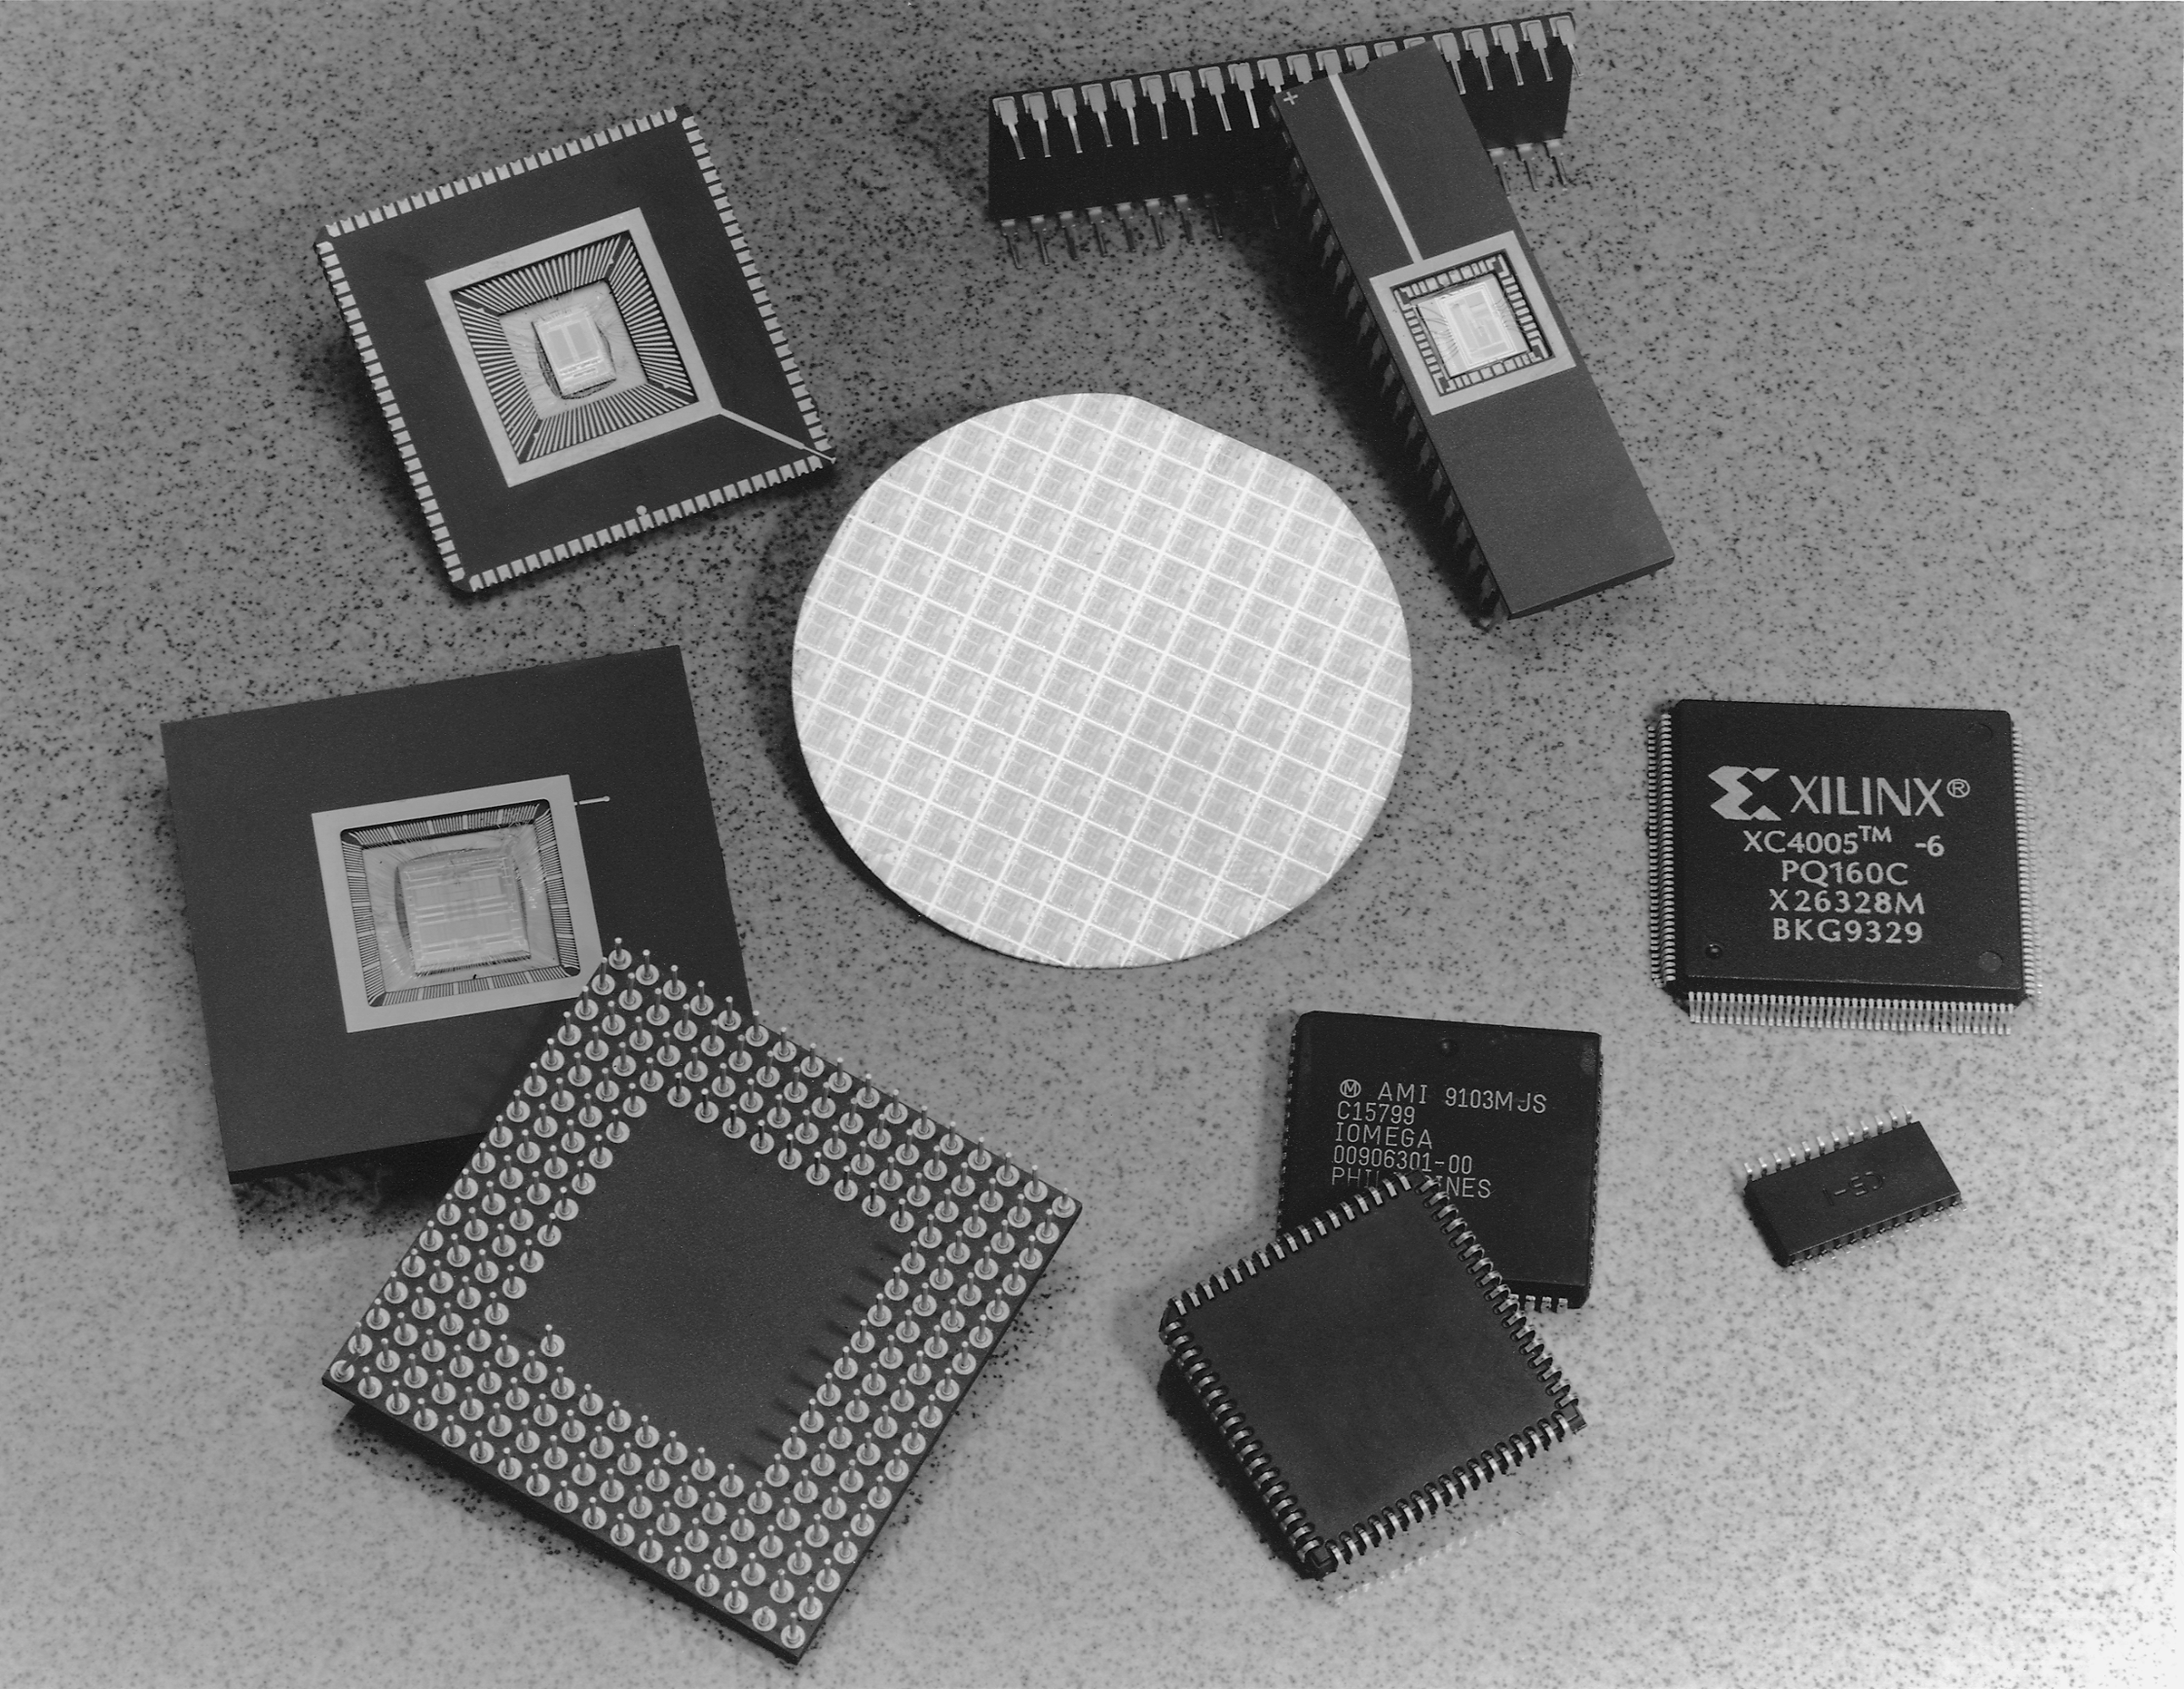
Package Types

Slide 36
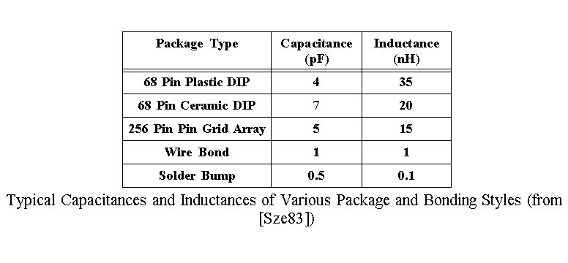
Package Parameters

Slide 37
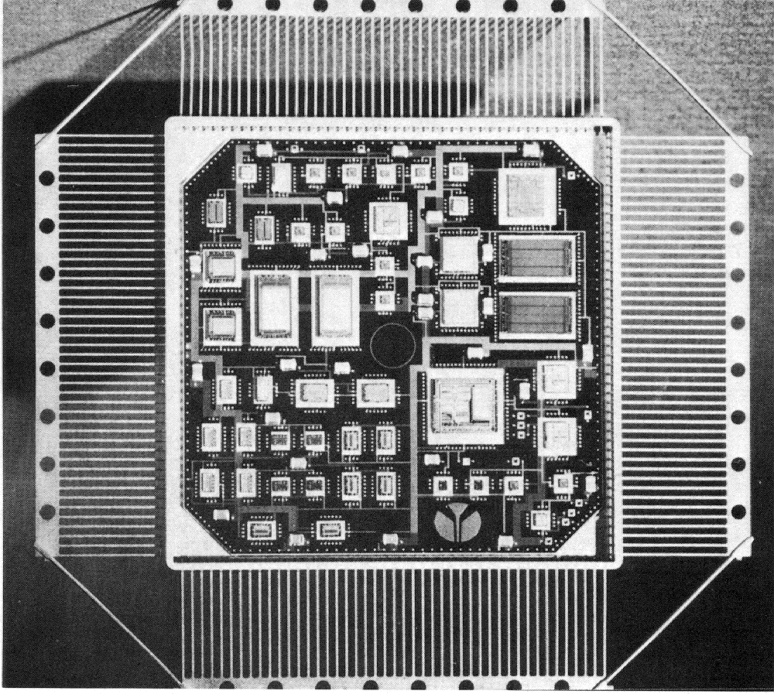
Multi-Chip Modules

